Slide 1

“Biye Shaadi” A Matrimony Website
Prepared by
Suraiya Mahmuda (364)
Lamia Binta Latif(366)
Fatima Binte Aziz(367)

Slide 2
Contents
Objective
Motivation
System Architecture
Use case diagram
Class diagram
Features Description
Project Demonstration

Slide 3
Objective
The main objective of this application is to facilitate the user by providing profiles of bride or groom and other information regarding them online.
User can get information regarding their dream life partner at his/her home at his/her convenience..
Notes:
so the first ques here, what is matrimony? and here you can see
Matrimony website is an online based platform where you can find your soulmate. It will reduce all the hassle of the conventional marriage system. You can visit our website as a visitor. Do the registration to send messages to your chosen one.
Audience: Our audience is the people who are seeking a life partner for the purpose of marriage.

Slide 4
Motivation
The main reason this project is much fascinating is that this project gives the facility of finding life partner, a basic human need in an easy way. This project ensures obstacle free way of finding a partner.
This project is a very much popular in India. People of Bangladesh are still not used to the trend of online matrimony system. This initiative will help people to find soulmates in an efficient way.

Slide 5
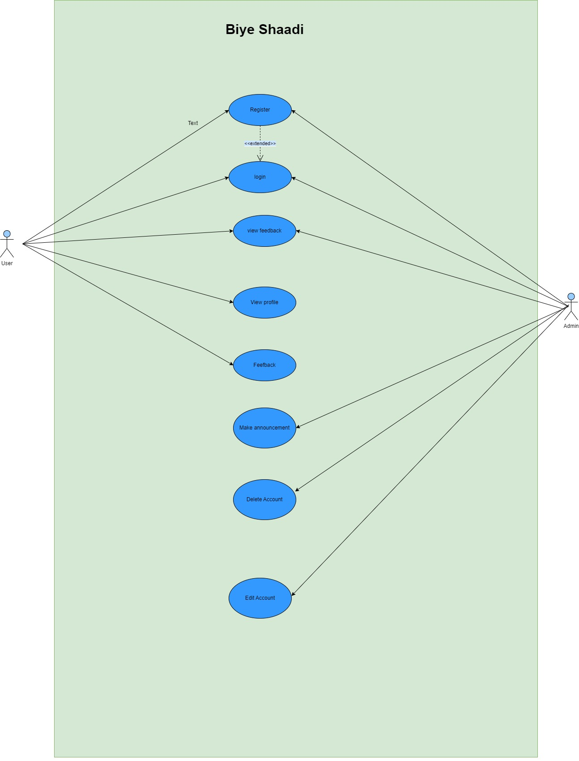
Use case diagram

Slide 6
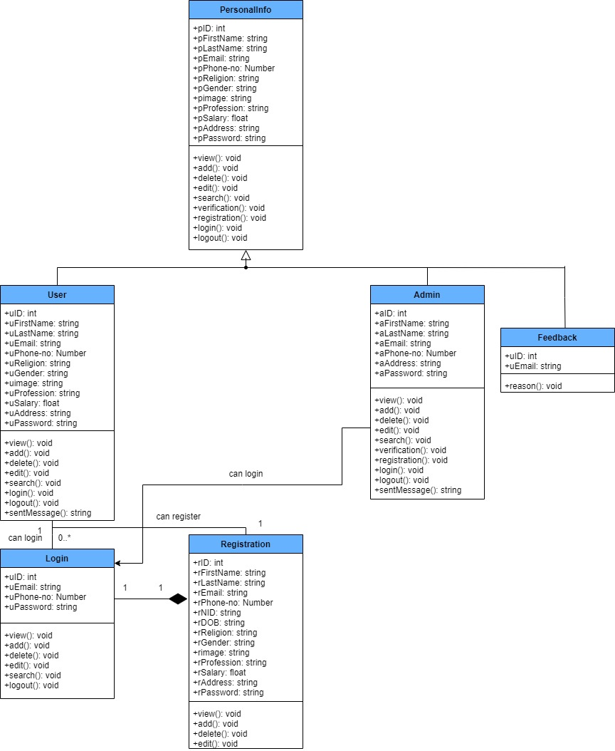
Class diagram for “Biye Shaadi”

Slide 7
Key Features:
Home : It is a welcome page for users.
Registration: Users can register through sign up page.
Login: Users can log into the website.
View Profiles: In this section, users can view matching profiles
Profile Details: Here, users can view details of a member.
Success story: Successful matchmaking story that have been accomplished using the website are told in this section.
Feedback: Users can convey feedback in this website.

Slide 8
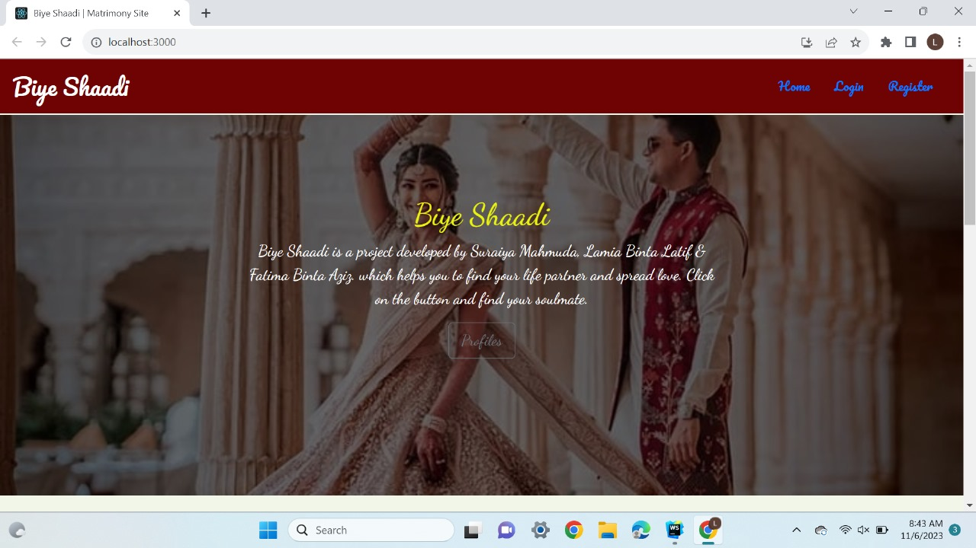
Home Page

Slide 9
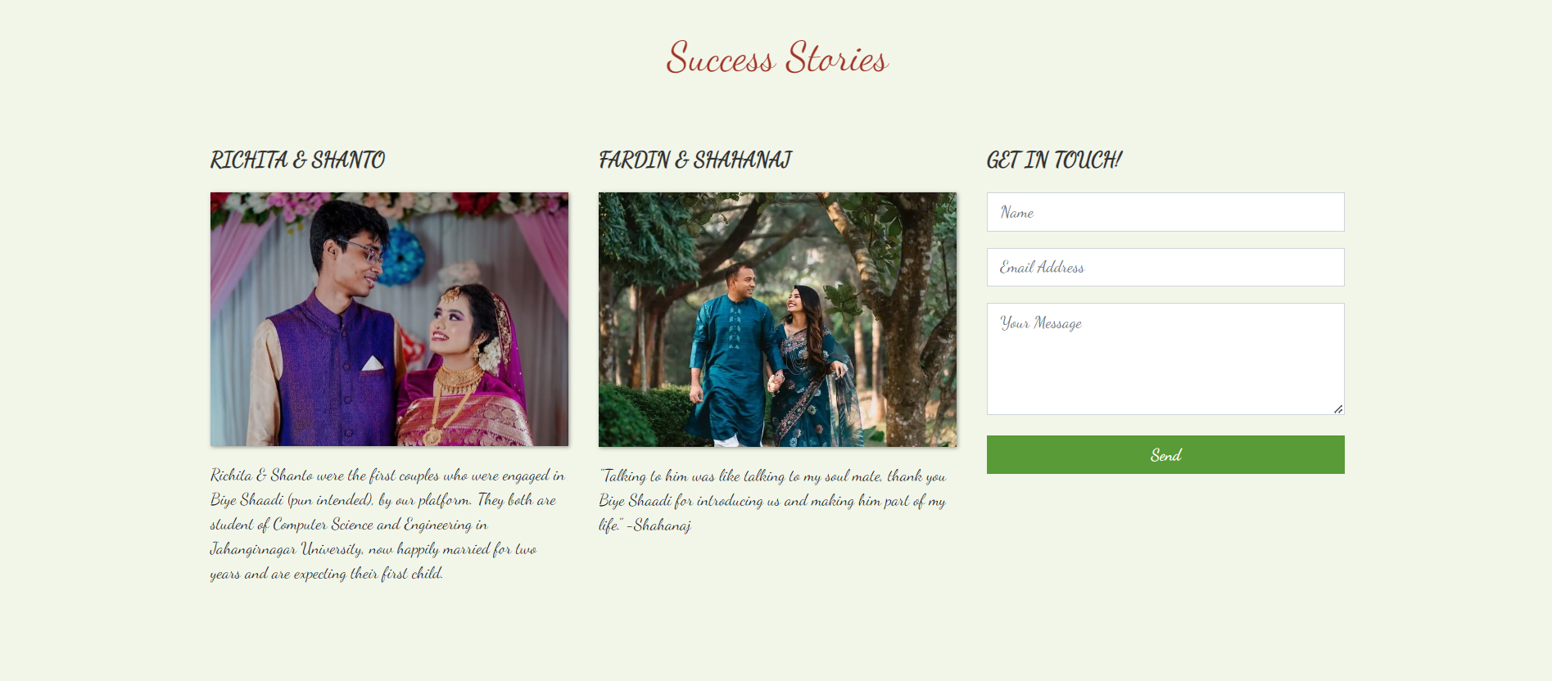
Home Page(Continued..)

Slide 10
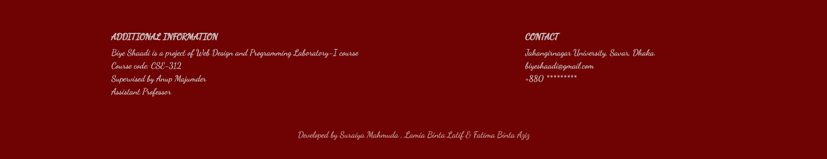
Home Page(Continued..)

Slide 11
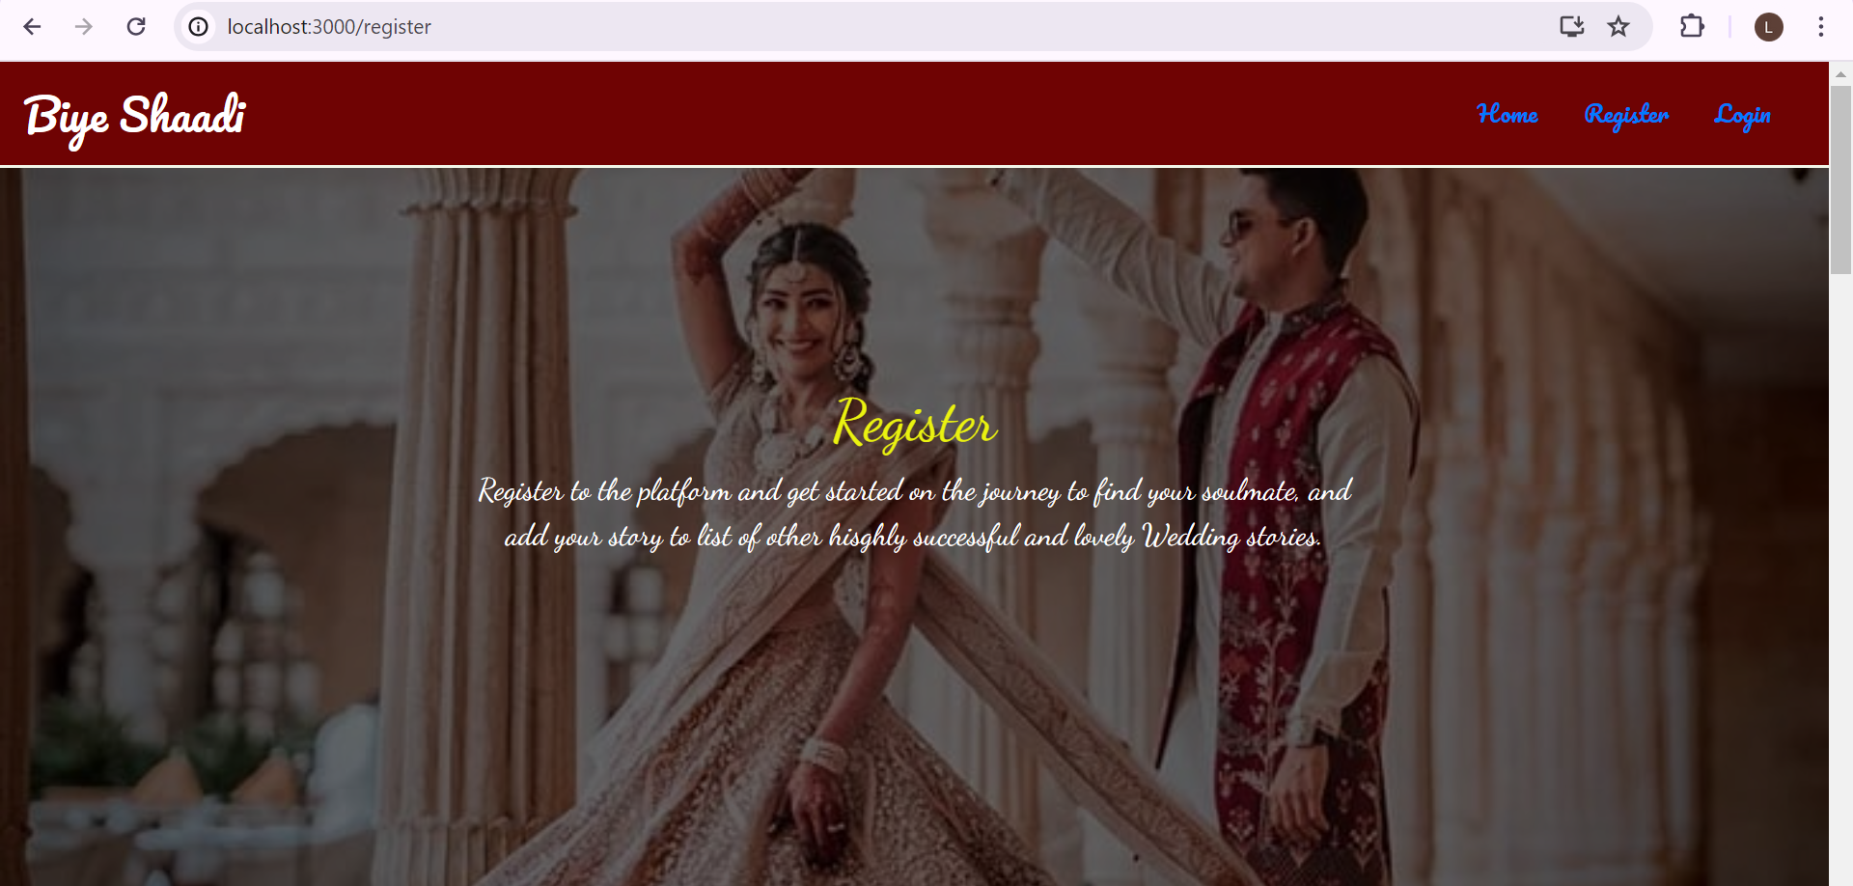
Registration Page

Slide 12
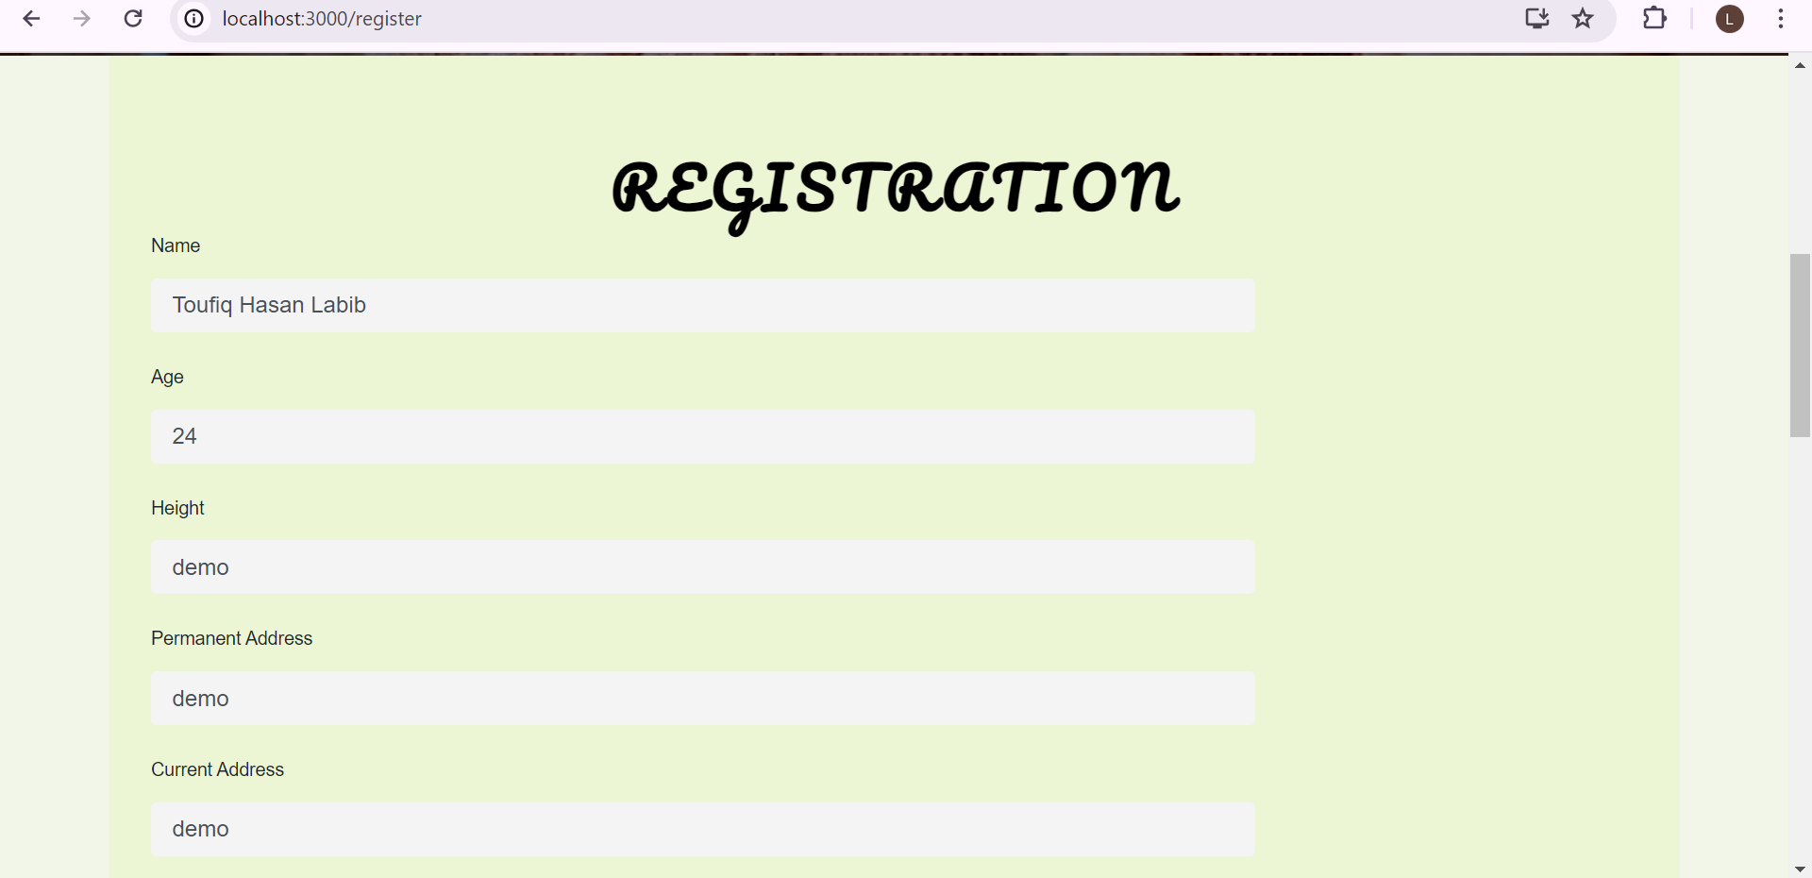
Registration Page(Continued)

Slide 13
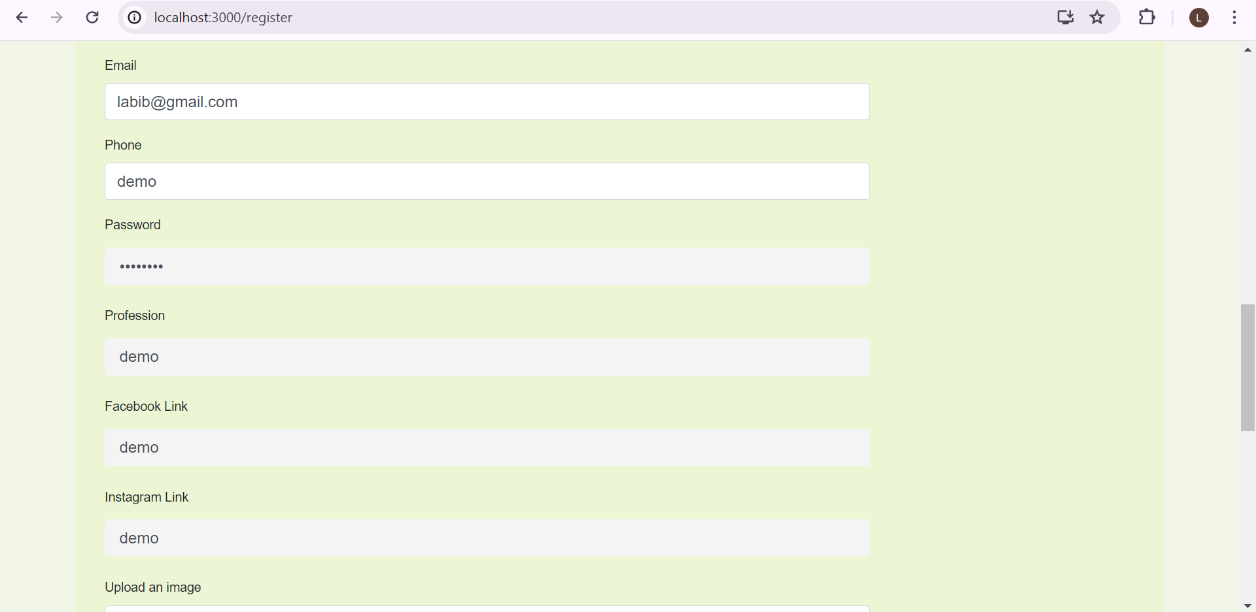
Registration Page(Continued)

Slide 14
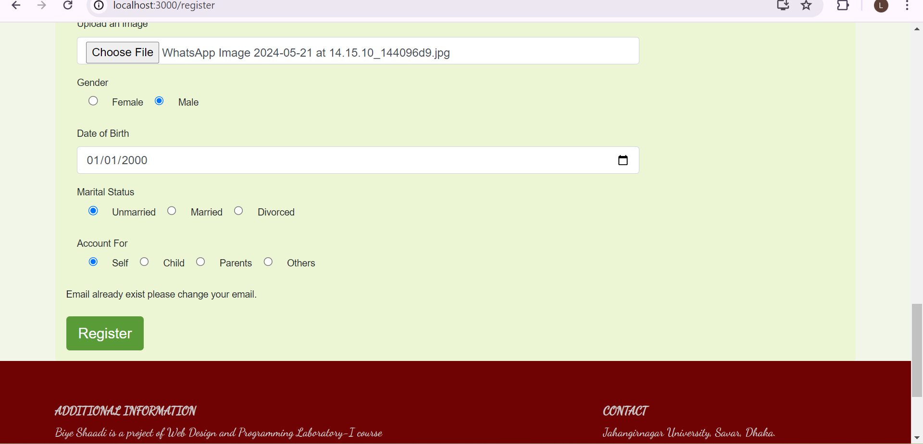
Registration Page(Continued)

Slide 15
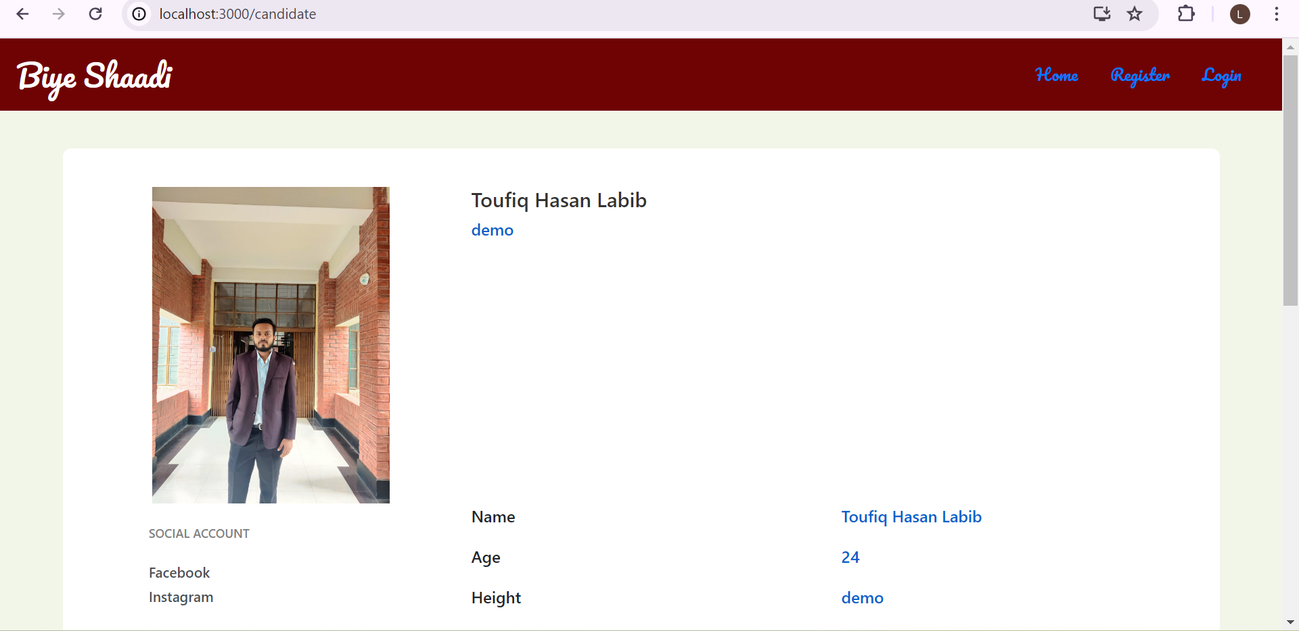
Registered Bride/Groom

Slide 16
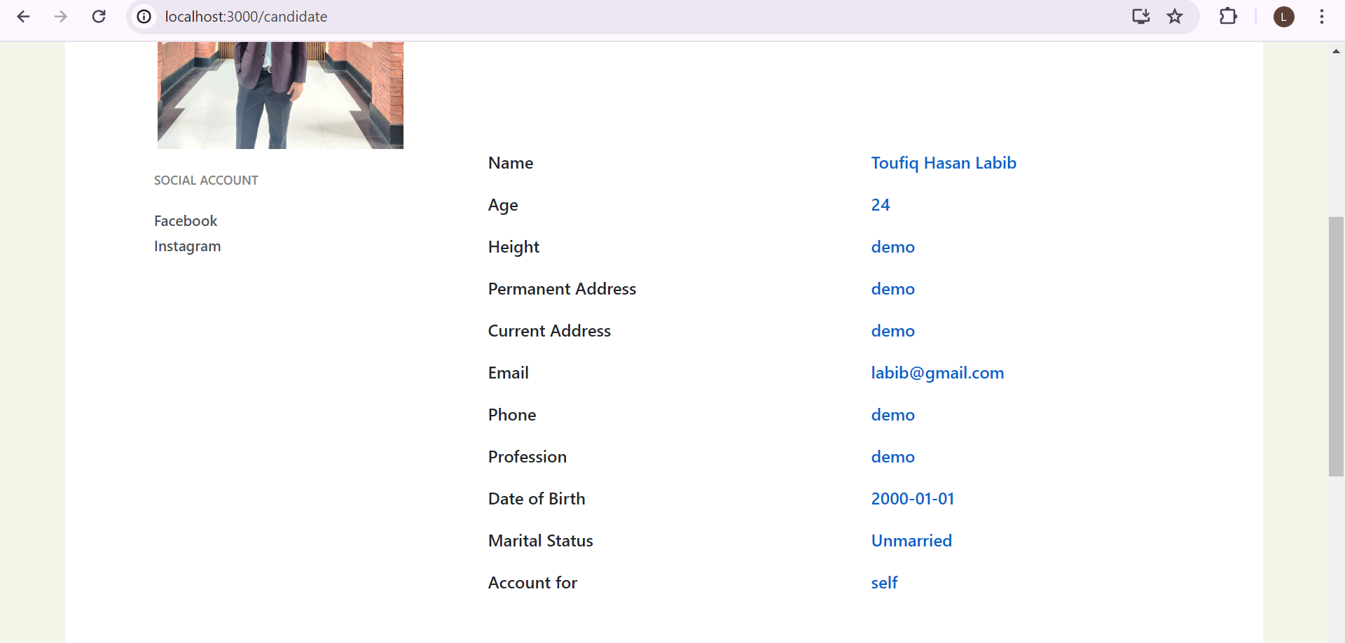
Registered Bride/Groom(Continued)

Slide 17
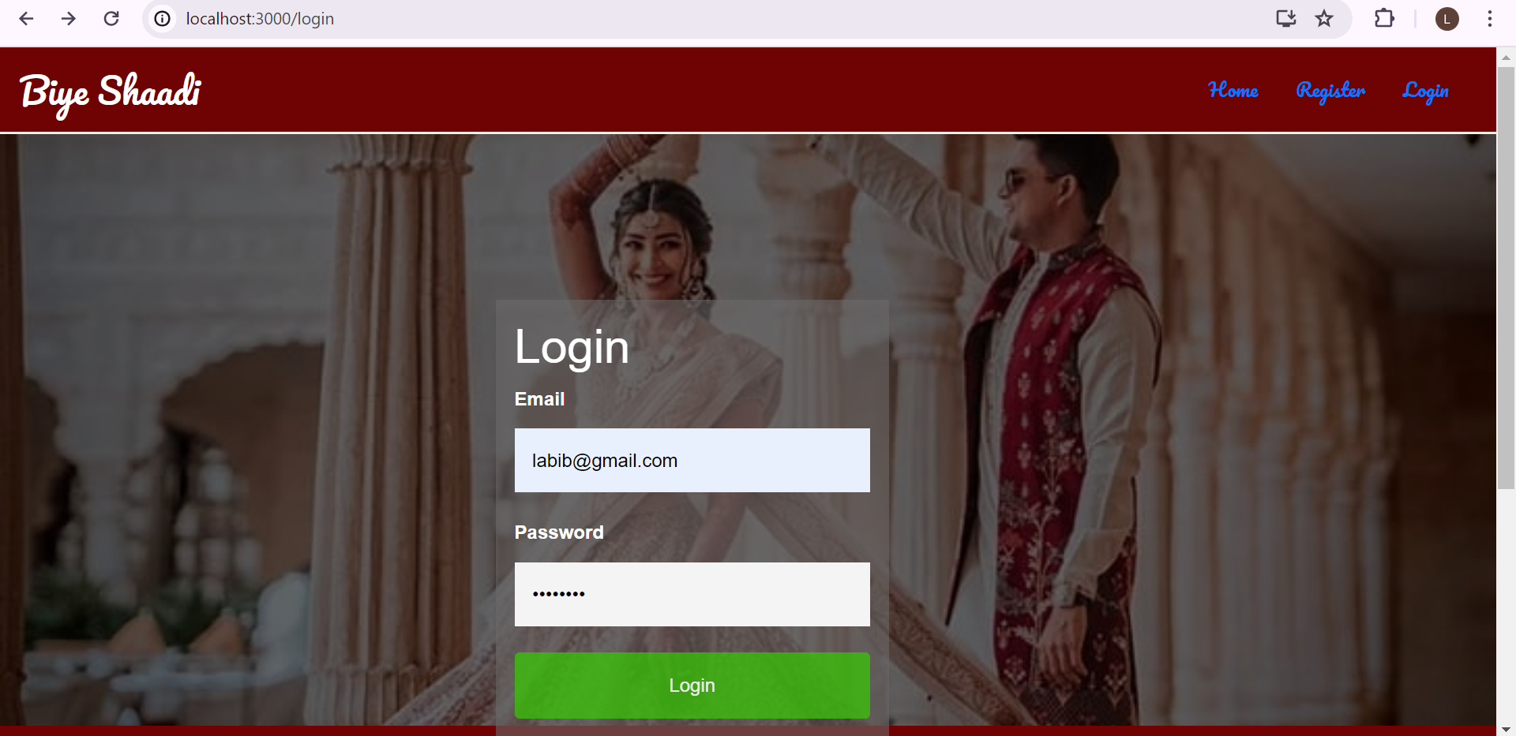
Login Page

Slide 18
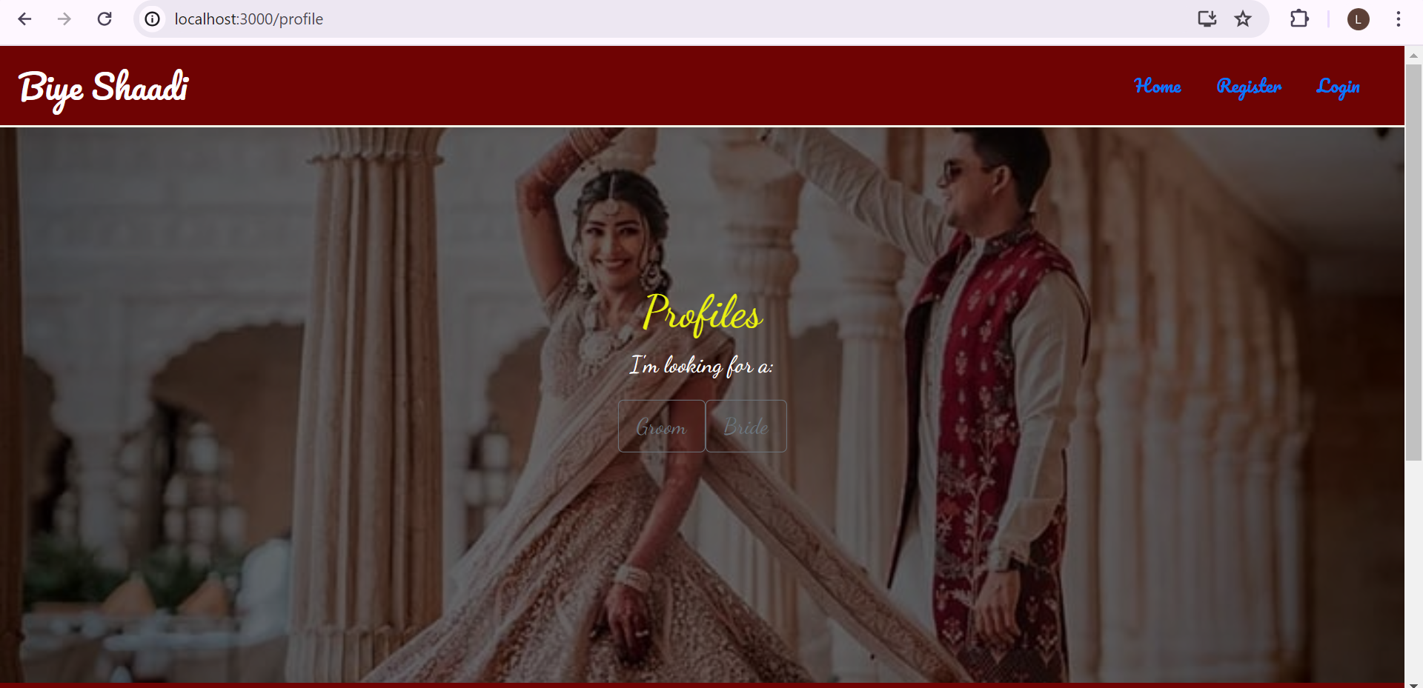
Profile Page

Slide 19
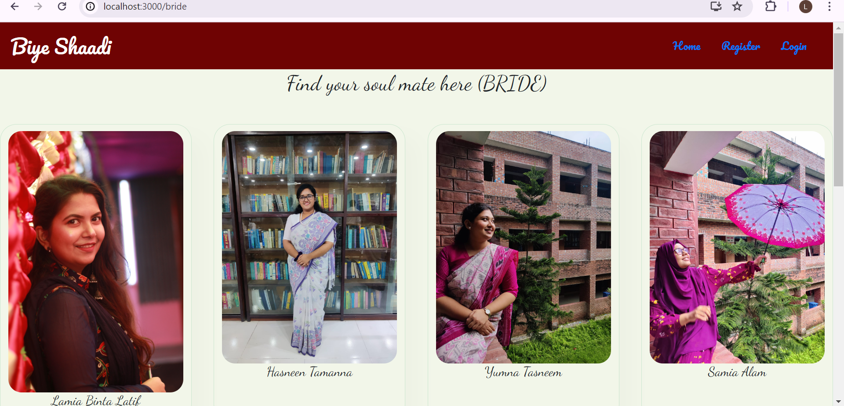
Bride List

Slide 20
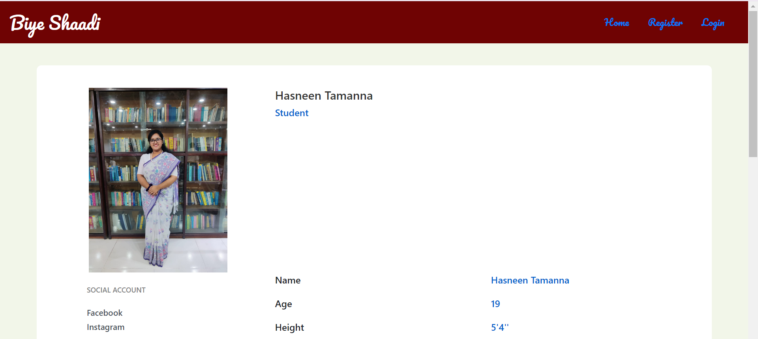
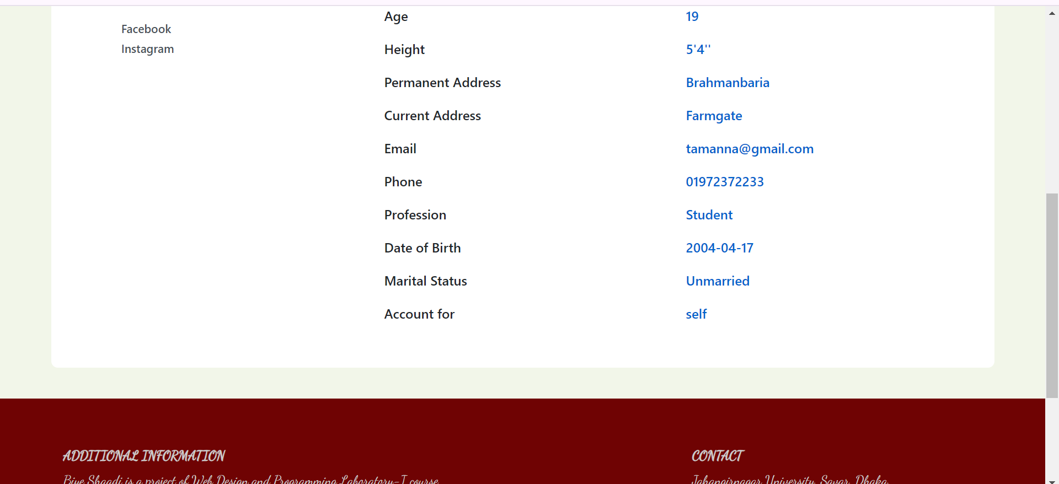
Bride Profile (Sample)

Slide 21
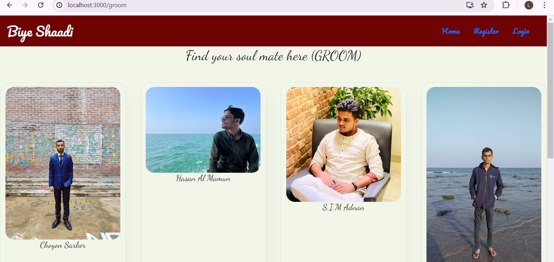
Groom List

Slide 22
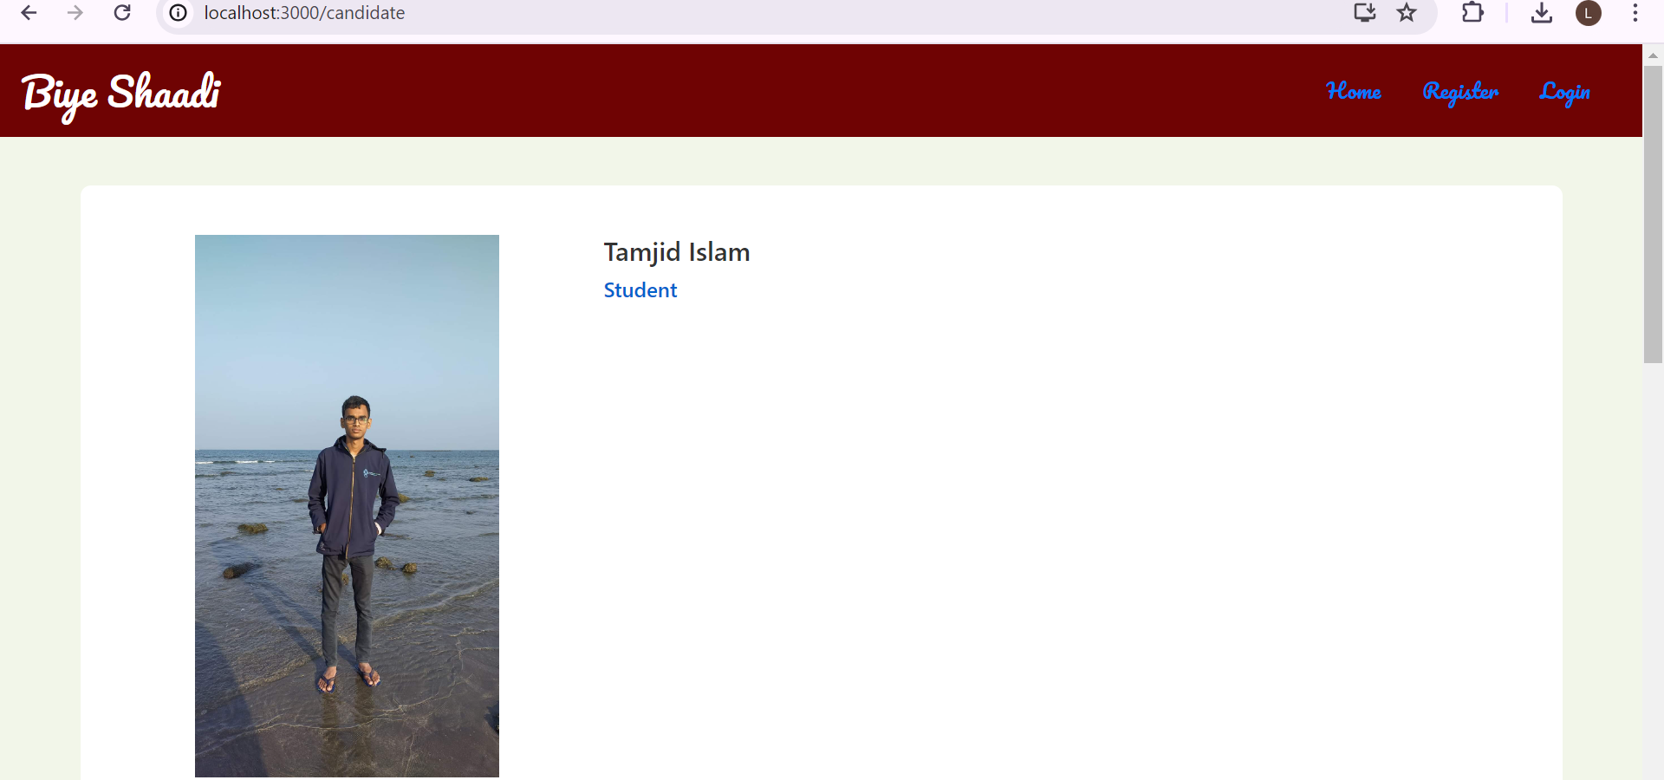
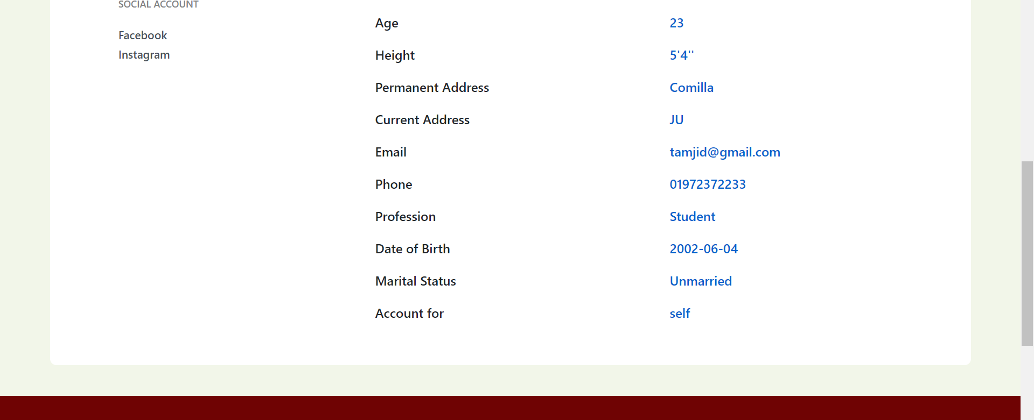
Groom Profile (Sample)

Slide 23
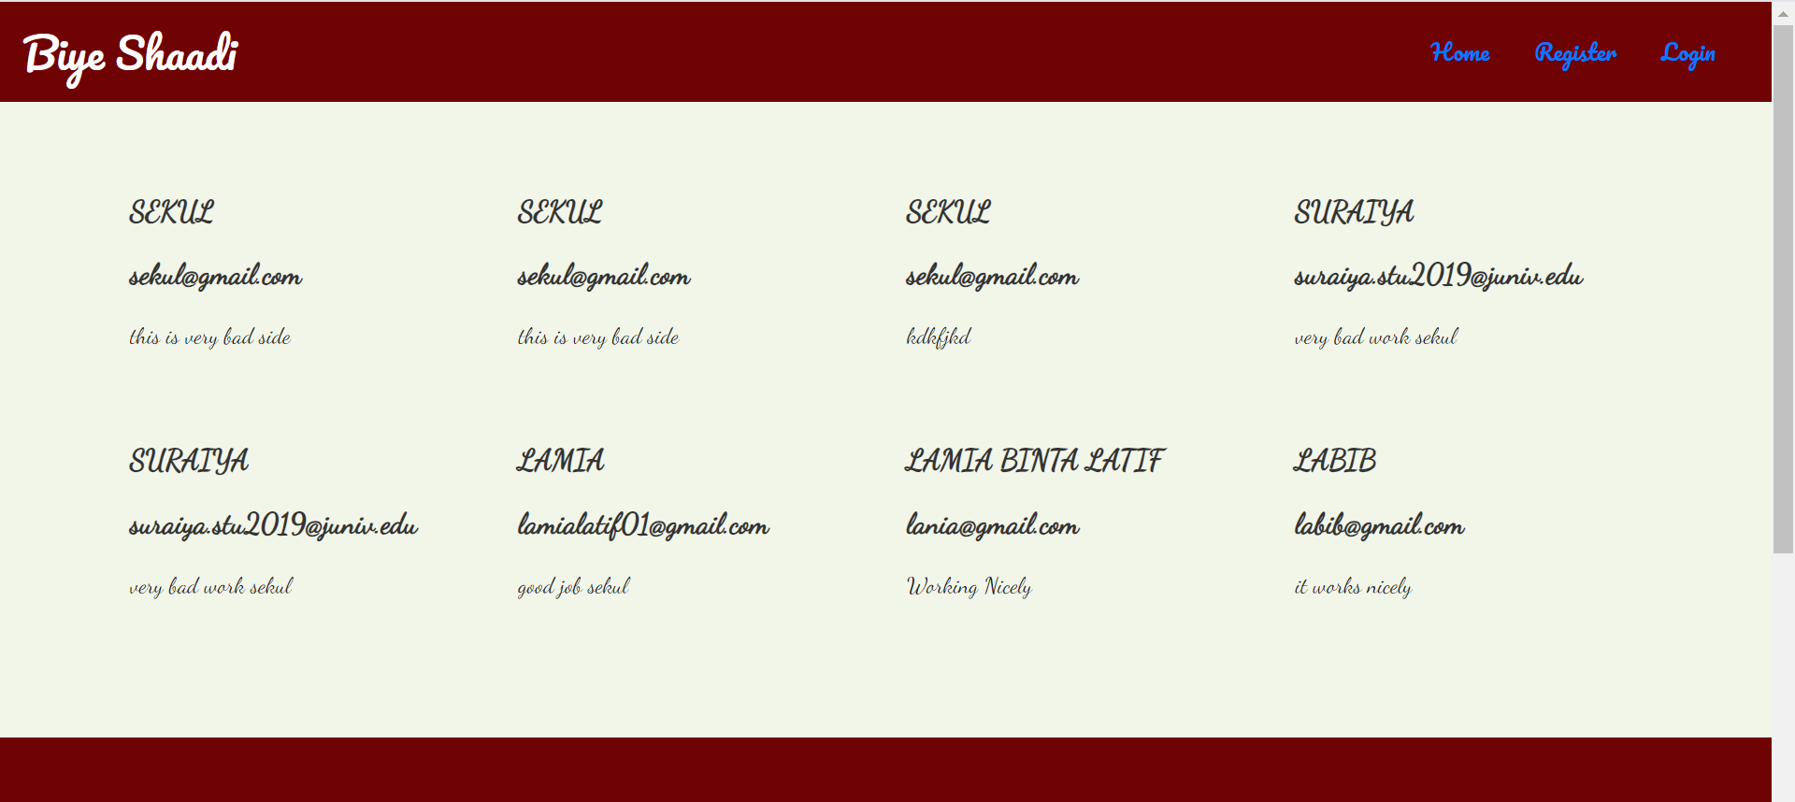
View Feedback

Slide 24
Front-End Language
HTML(HypertText Markup Language): Gives structure to the web page.
CSS(Cascading Style Sheet): To style and layout web pages.
JavaScript: Interaction between webpages.
BOOTSTRAP: Framework of CSS and JavaScript.
REACT JS: Highly productive JavaScript framework.

Slide 25
Back-End Language
Python(Django)

Slide 26
Software Used
Visual studio, WebStorm, PyCharm or other Text Editor.
Google Chrome or any other Browser.

Slide 27
Conclusion
The project entitled “Biye Shaadi” is developed using HTML, CSS, Bootstrap, JavaScript and ReactJS as Front-End Language and Python(Django) is used as Back-End Language .
This project comprises the process of finding dream life partner.

Slide 28


